Slide 1

Implementation of Data Warehouse and Business Intelligence for Dominick’s Finer Foods
Group #5
Arpita Deshmukh, Shilpa Chanshetti, Shruthi Shetty

Slide 2
Business Questions
BQ1. What is the average profit margin of Bath Tissues across all the stores to determine store with low-profit margin?
BQ2. What is the total sales of Beer during the holiday season?
BQ3. Which pricing tier produces the highest bottled juice sales during Christmas Week?
BQ4.Which Bath Soap product has a decreasing sales trend across different zones?
BQ5. What category of coupons are redeemed the most for the entire duration?

Slide 3
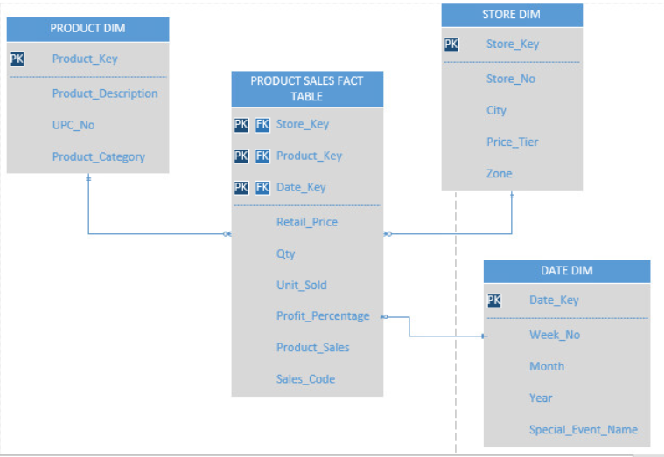
Star Schema: Kimball’s Approach
BQ1, BQ2, BQ3, BQ4

Slide 4
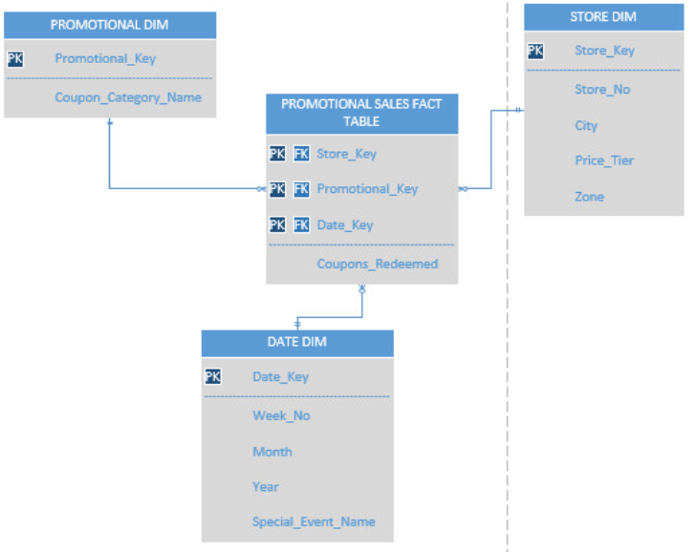
Cont’d
BQ5

Slide 5
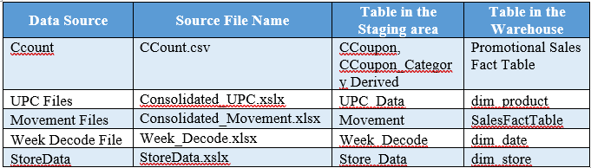
Extract, Transform & Load: SSIS
Data Source Files , Data Staging and Warehouse Tables

Slide 6
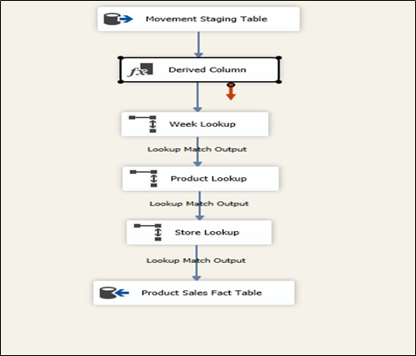
Extract, Transform & Load: SSIS
Product Sales Fact Table

Slide 7
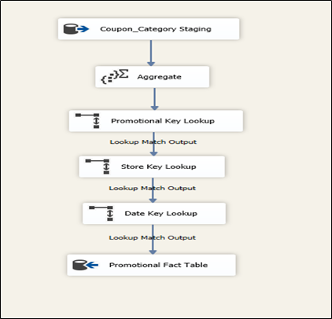
Extract, Transform & Load: SSIS
Promotional Fact Table

Slide 8
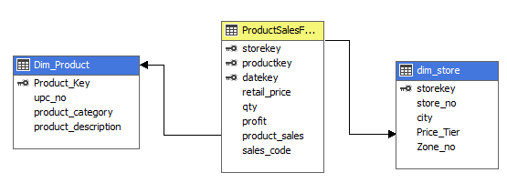
Analysis & Reporting: SSAS, SSRS, Report Builder
Average profit margin of Bath Tissues across all the stores to determine store with low-profit margin? (SSAS)
Reporting Tool | Business Questions
SSAS | BQ1
Report Builder 3.0 | BQ2
SSAS + SSRS | BQ3
SSRS | BQ4, BQ5
Attributes Displayed: Store number, Avg Profit

Slide 9
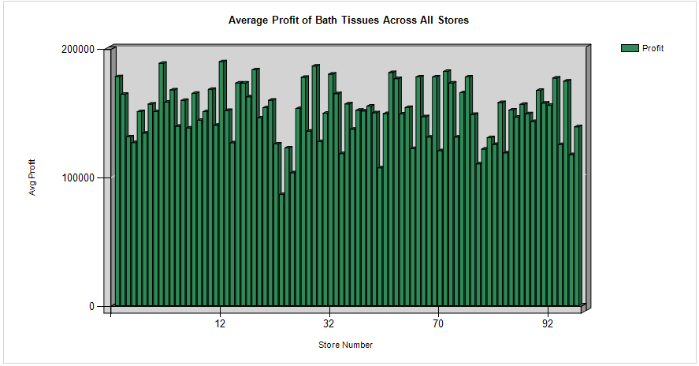
Average profit margin of Bath Tissues across all the stores to determine store with low-profit margin

Slide 10
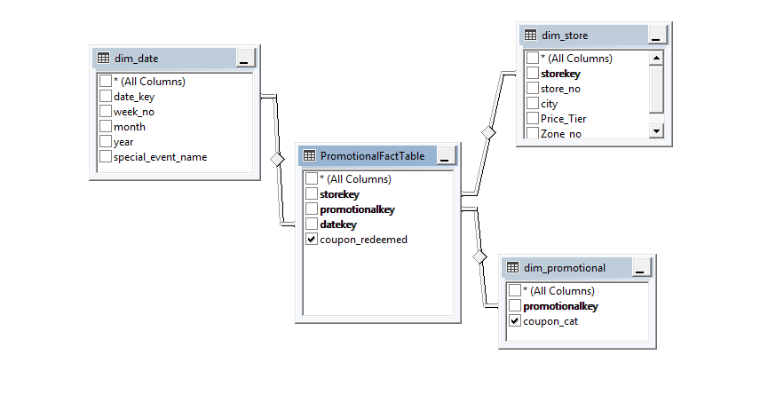
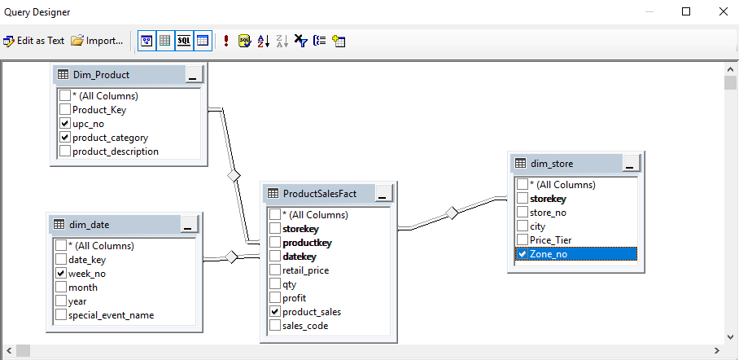
The Bath Soap product which has a decreasing sales trend across different zones? (SSRS)
Attributes Displayed:
UPC Number, Zone Number, Product Sales
The category of coupons which are redeemed the most for the entire duration? (SSRS)
Attributes Displayed:
Coupon Category, Number of Coupons redeemed

Slide 11
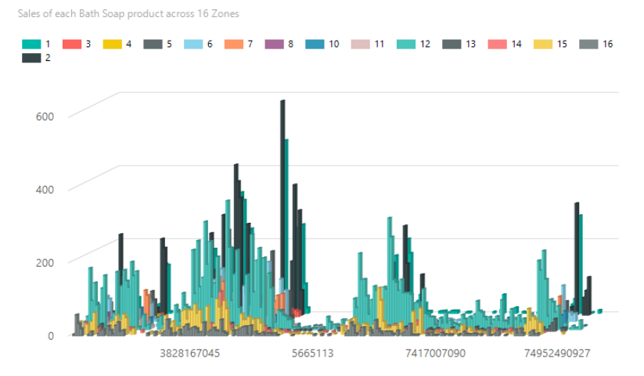
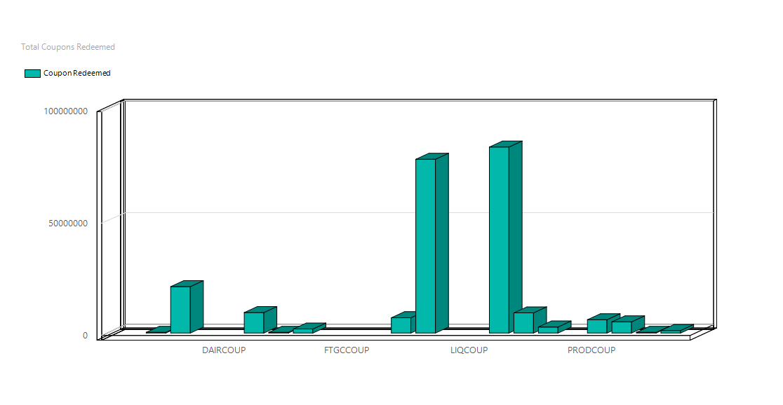
The Bath Soap product which has a decreasing sales trend across different zones
The category of coupons which are redeemed the most for the entire duration

Slide 12
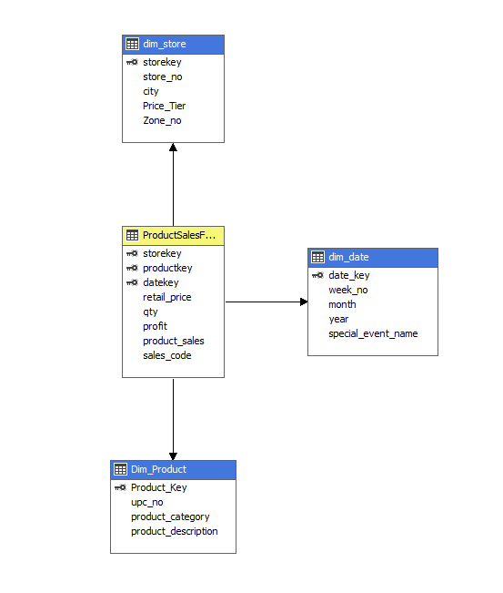
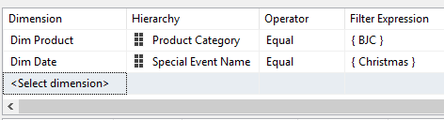
The pricing tier that produces the highest bottled juice sales during Christmas Week (SSAS+SSRS)
SSRS Filters
Attributes Displayed:
Price Tier, Product Sales

Slide 13
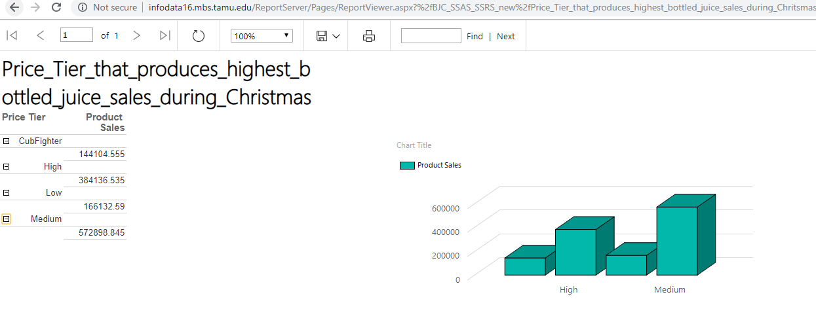
The pricing tier that produces the highest bottled juice sales during Christmas Week

Slide 14
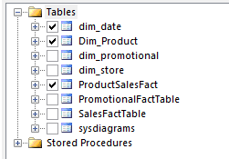
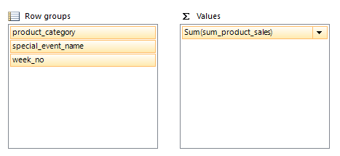
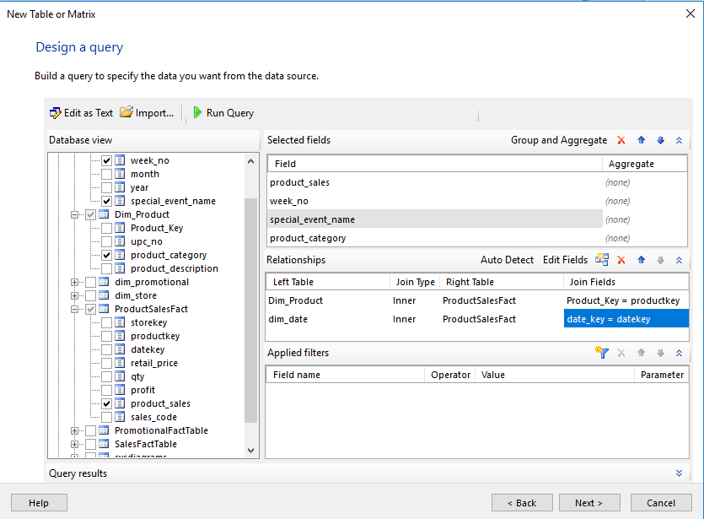
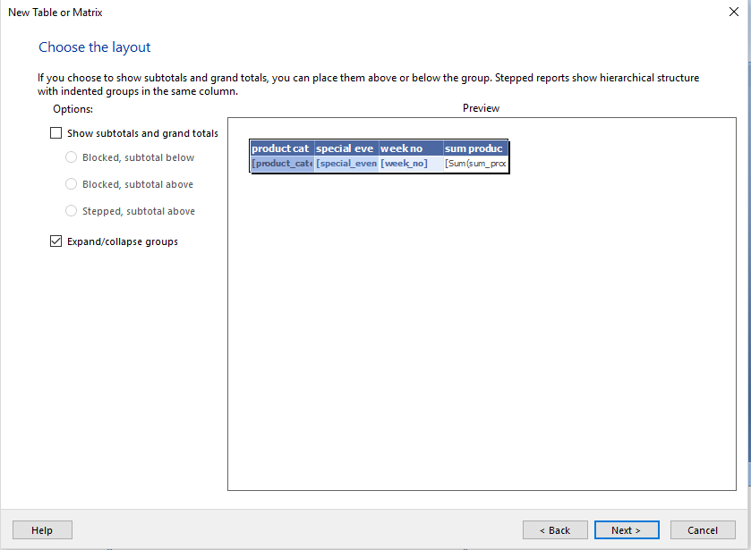
Total sales of Beer during the holiday season (Report Builder 3.0)
Attributes Displayed:
Product category, Special Event Name, Week Number, Sum of product sales

Slide 15
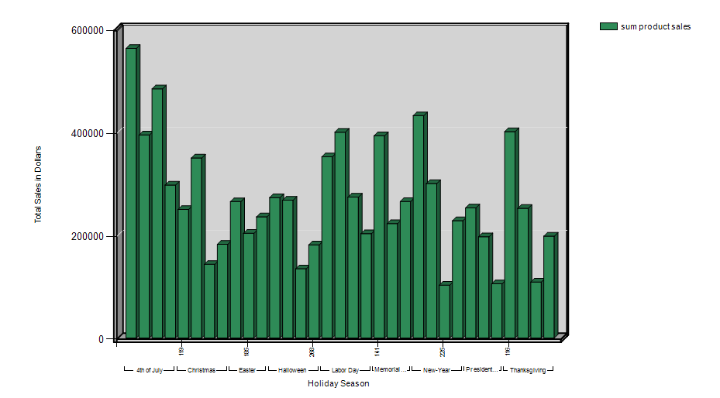
Total sales of Beer during the holiday season

Slide 16
Any Questions?

